Slide 1
Selling the Carbon Commons: Decentralization, Commercialization, Forest Tenure and Carbon Trading in Nepal’s Community Forestry
Bryan R. Bushley, University of Hawai’i at Manoa & East-West Center (bushley@hawaii.edu)
Dil Raj Khanal, Federation of Community Forest Users, Nepal
Land Tenure and Forest Carbon Management, LTC Workshop
University of Madison, Wisconsin, October 21-22, 2011

Slide 2
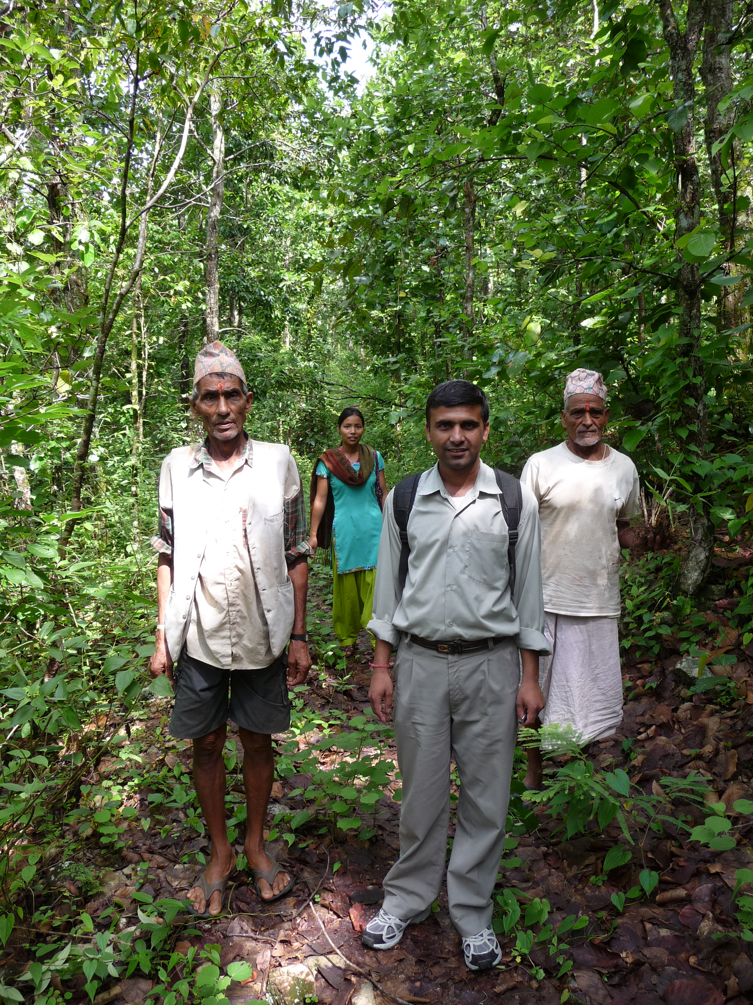
Key questions
How are tenure security, decentralization and commercialization related in Nepal’s community forestry?
How could market-based mechanisms like carbon trading and REDD impact decentralization and community tenure security?
Are effective and equitable carbon-trading regimes possible without clear legal definition and assignment of land and carbon rights?
Photo by Bryan Bushley (2008)

Slide 3

Overview
National context
History and status of decentralization, tenure and commercialization
Linkages—decentralization, commercialization, tenure
Market mechanisms, carbon trading, and tenure security
Challenges, lessons and implications for REDD
Photo by Bryan Bushley (2010)

Slide 4
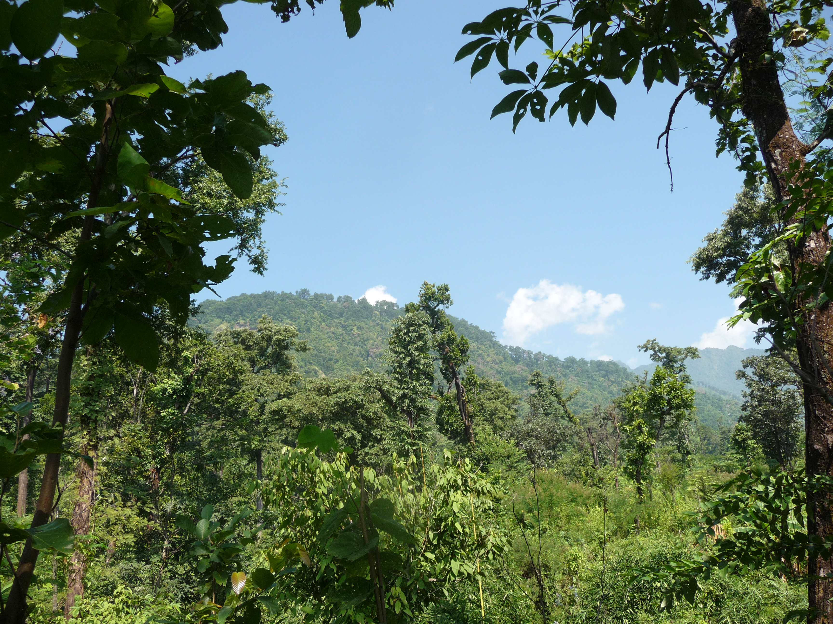
“Hariyo ban, Nepal ko dhan” (Green forest is Nepal’s wealth)
Photo by Bryan Bushley (2010)
“Nepal’s experience with community forestry management demonstrates a clear mechanism for the generation of carbon credits at the local level… Nepal invites Parties and observers to learn from its experiences of community forestry in the development of an equitable and socially just REDD mechanism.”
Ganesh Shah, Minister for Environment, Science and Technology and Head of Nepalese Delegation to the COP 14 UNFCCC Climate Change meeting in Poznan, Poland 11-12 December 2008 (http://climatenepal.wordpress.com)
Notes:
Put later with section on market mechanisms?

Slide 5
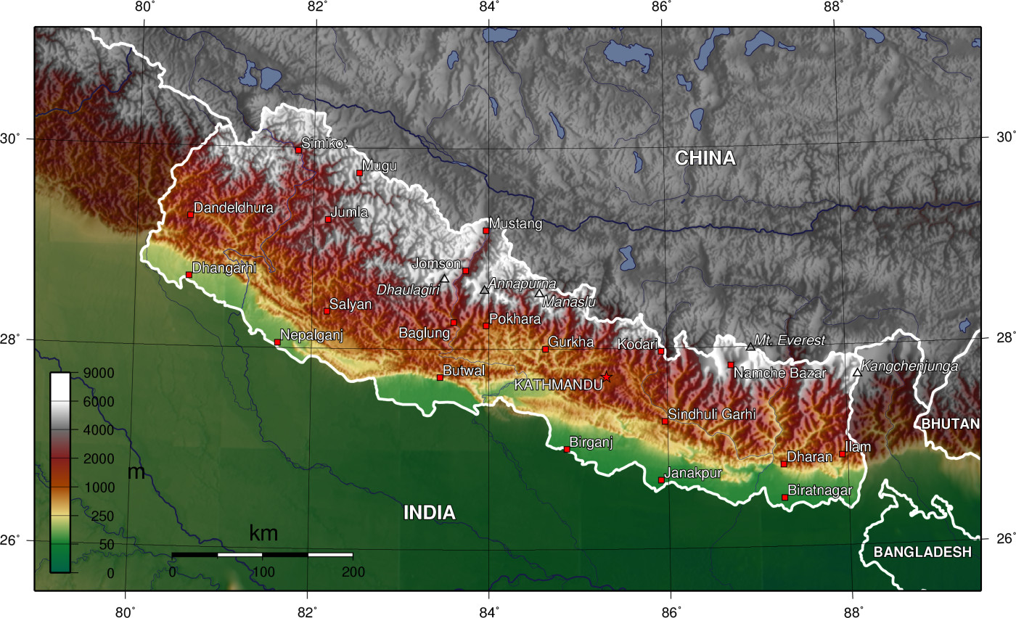
1. National Context Geographical zones of Nepal
Notes:
Three regions, basic geographic, ecological and demographic characteristics

Slide 6
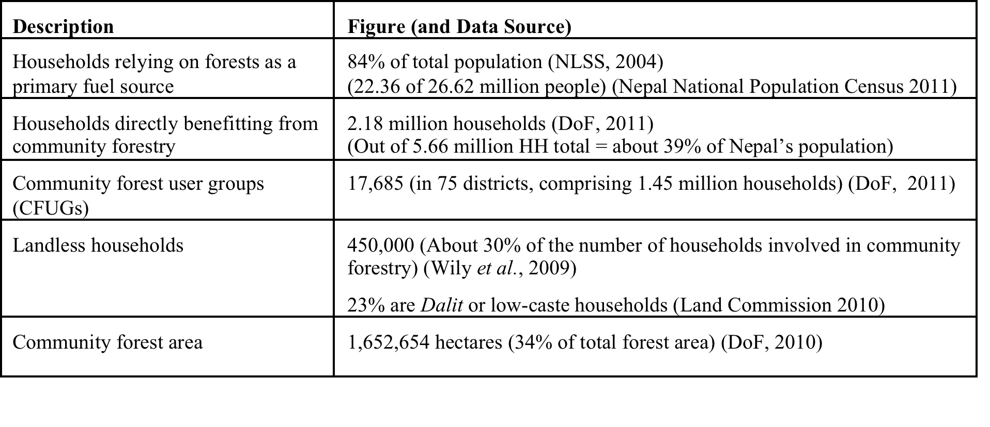
Dependence on forests for livelihoods (Table 1)

Slide 7
2. History and status of decentrali-zation, tenure and commercialization
1850s-1957 Land owned by aristocratic landlords (Ranas)
1957 Private Forests Nationalization Act
1976 National Forestry Plan
1978 Panchayat Forest and Protected Forest Rules
1982/1987 Decentralization Act (committees, CFUGs)
1980s Donor-funded community forestry projects (World Bank, Australia, UK, Switzerland, USA)
1989 Master Plan of Forestry Sector (47% of budget to CF)
1993 Forest Act (legal basis for CF)
1995 Forest Regulations (bylaws and regulations)
1996 Formation of FECOFUN
Mid-1990s→ Donors support forest product commercialization
2005 → SFM certification pilot
2009 → Nepal REDD-readiness activities & pilots
2001/2009-10 Gov’t declares PAs & Forest Act Amend. (protests)

Slide 8
Tenure rights under different management regimes (Table 3)

Slide 9
Tenure status under community forestry
Community forest user group (CFUG) formation, with group constitution
Demarcation of land and development of operational plan (5-10 years) with District Forest Office (DFO)
CFUGs have management and use rights
Government owns land
Carbon rights undefined
15% tax on timber sales
Attempts by forestry bureaucracy and administrators to increase tax and curb community rights (amendment proposals, policy directives, local regulation)

Slide 10
Status of commercialization
Limited private investment in forestry (TCN)
Growth in local enterprises – timber, plywood, NTFPs
Main local uses – fuelwood, fodder, timber
Some CFUGs sell timber concessions to traders
Donor support for sustainable NTFP production
Nascent PES programs (hydropower royalties, drinking water, agriculture/aquaculture)
SFM certification program
Carbon trading (piloting only)
Notes:
TCN – Large public corporation under MoFSC that has dominated official timber industry for years. Recently (Oct 12, 2011) the Parliamentary Public Accounts Committee recommended closing it down.
Local enterprises exist, but get little public support and are heavily regulated

Slide 11
3. Linking decentralization, commercialization and tenure security
Decentralization
?
?
Commercial-
ization
Tenure
Security
?

Slide 12
Has decentralization increased tenure security for forest-dependent communities?
+
–
Communities have rights to manage, harvest and sell forest products
Forests are government property (except private agricultural land)
Community rights constrained by regulations and short-term agreements (5-10 years)
Local political, economic, livelihood rights at risk

Slide 13
Has decentralization of forest governance facilitated commercialization among CFUGs?
+
–
Built CFUGs’ capacity and awareness to engage in income-generating activities
Training and financial support for production and marketing of valuable forest products
Legal provisions to establish local enterprises
Prioritized political over economic autonomy (low-value products)
Bureaucratic regulations and practices restrict income potential (permission, taxes)
Low incentive for financial/labor investments in large income-generating activities
Necessary, yet insufficient condition

Slide 14
What impact has commercialization had on tenure security?
+
–
Gives CFUGs incentive to develop and protect forest resources
Reinforced customary tenure – local norms, rules and practices for management, harvesting, monitoring, enforcement
Low recognition of community resource and land tenure rights by government, outsiders
Persistent restrictions on sale, management, use of forest products
Limited impact on formal tenure

Slide 15
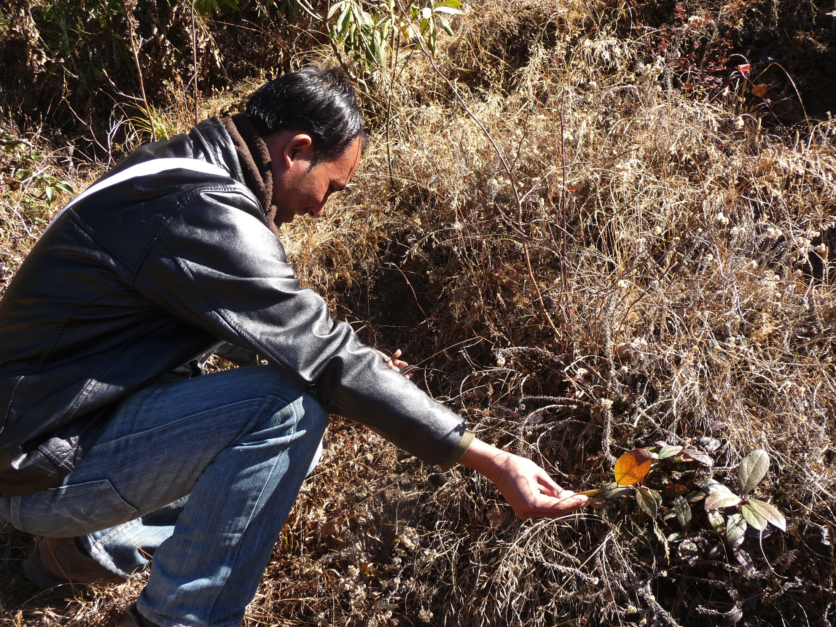
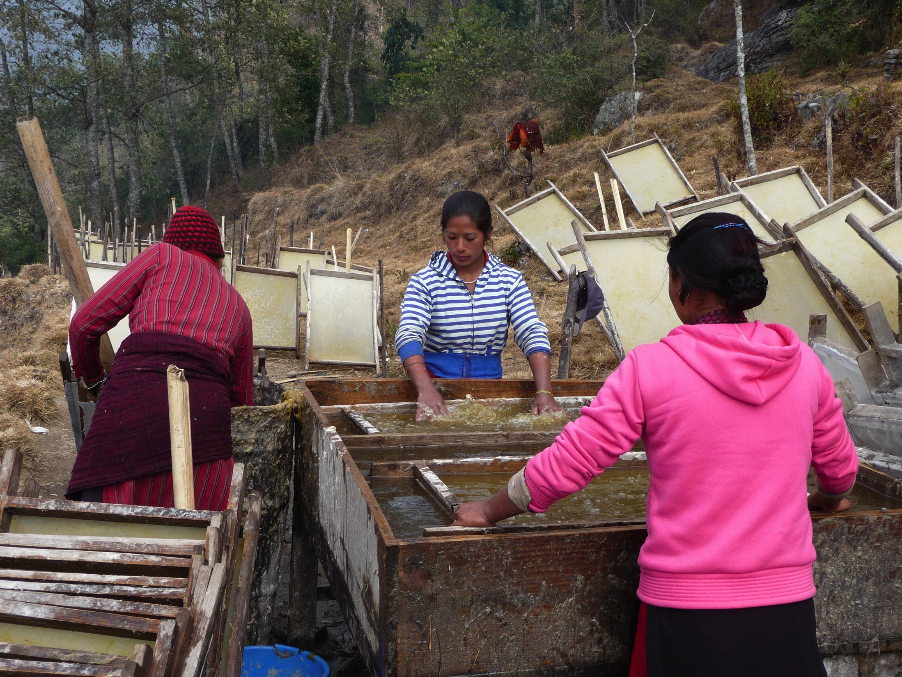
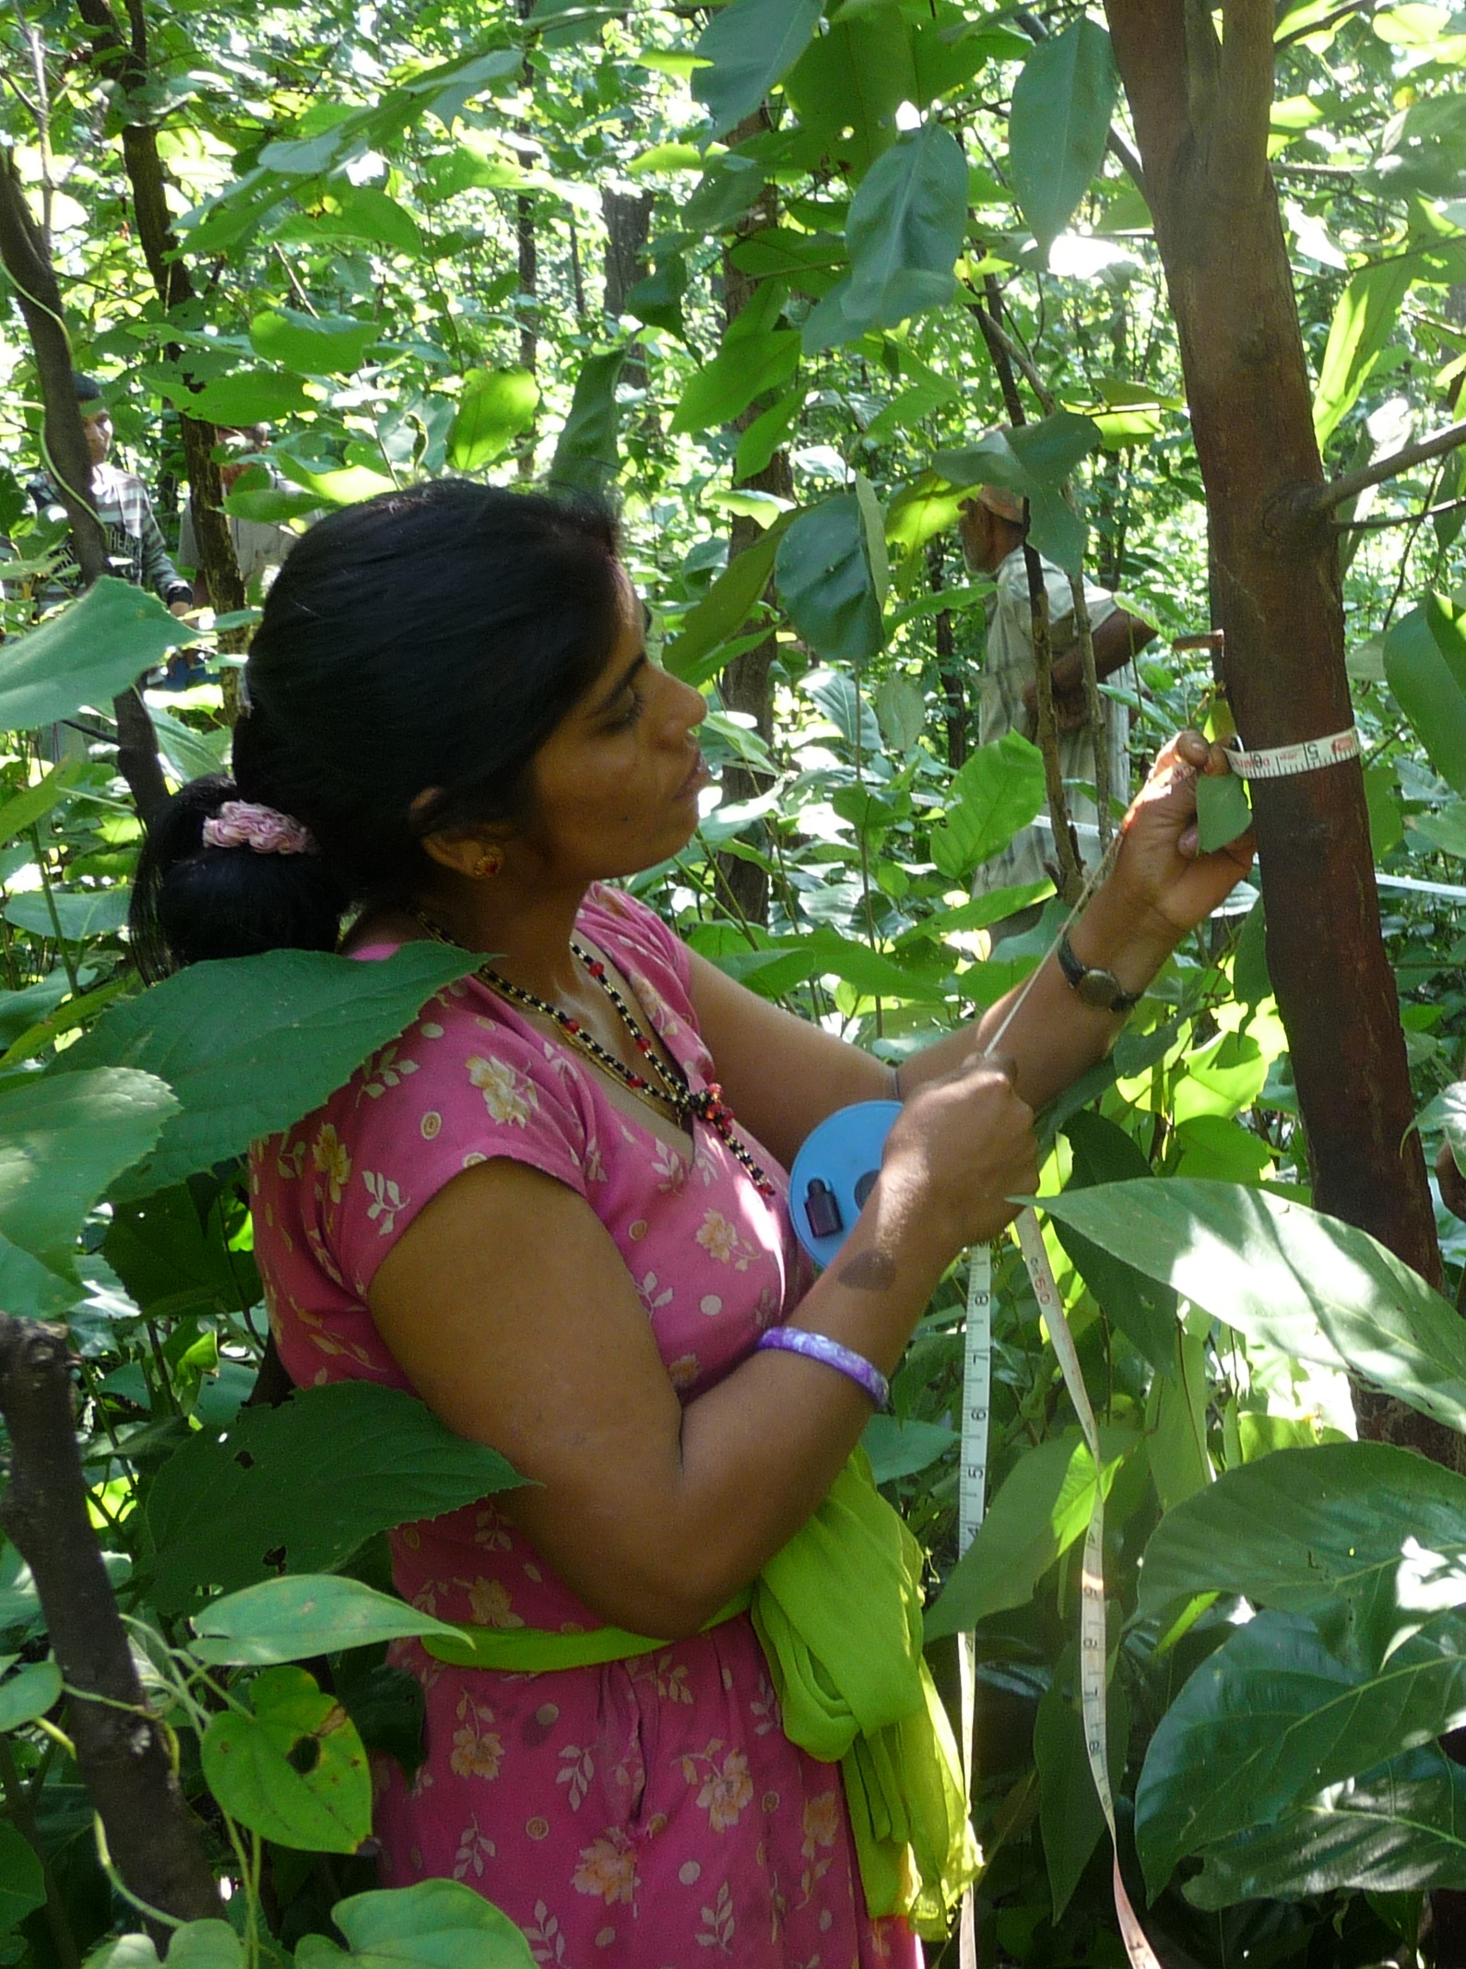
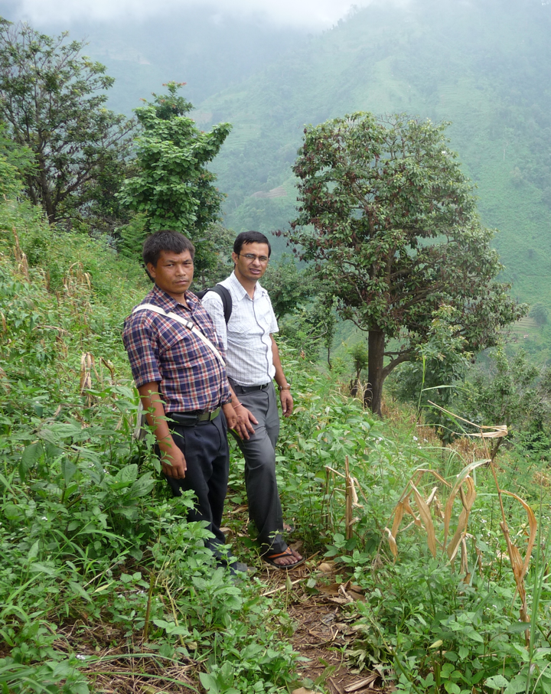
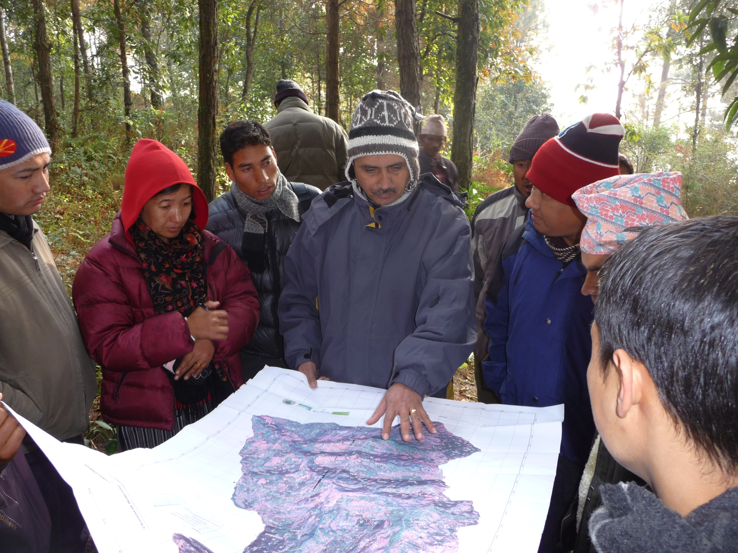
5. Market mechanisms, carbon trading (REDD), and tenure security
Photos by Bryan Bushley (2009-2010)

Slide 16
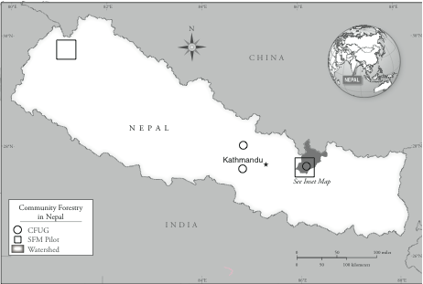
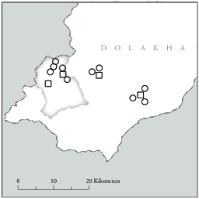
Geography of SFM certification & REDD
Dolakha
SFM Certification &
REDD Pilot Watershed
SFM pilot district
REDD pilot site
(watershed)
Certified CFUG
Certified
enterprise
REDD pilot site
(watershed)
Source: Land Tenure Center,
University of Wisconsin Madison

Slide 17
Lessons from SFM Certification (2005 – Present)
Certified CFUGs:
Limited financial benefits
Insufficient market linkages (monopsony)
Same selling price as non-certified CFUGs + additional transaction (MRV) costs (=higher net costs)
Some extra support from donors and government
Low control over what products they sell, where, price
Potential for adverse impacts on access of marginalized groups, and customary regimes(?)

Slide 18
Nepal’s involvement in REDD
COP negotiations and related events
International
WB FCPF membership and support
National
REDD Forestry & Climate Change Cell, RPP process
Community
Carbon forestry piloting
REDD piloting
2005
2006
2007
2008
2009
2010
2011
2012
Year
Notes:
2007-2010: Active involvement in UNFCCC negotiations and other events
2008 to present: Support from World Bank’s Forest Carbon Partnership Facility (FCPF) for ‘REDD readiness’ activities
2009 REDD Forestry and Climate Change Cell established at MoFSC
2009: Piloting activities in different areas
2009 - April 2010: Readiness Proposal Preparation (RPP) process under FCPF

Slide 19
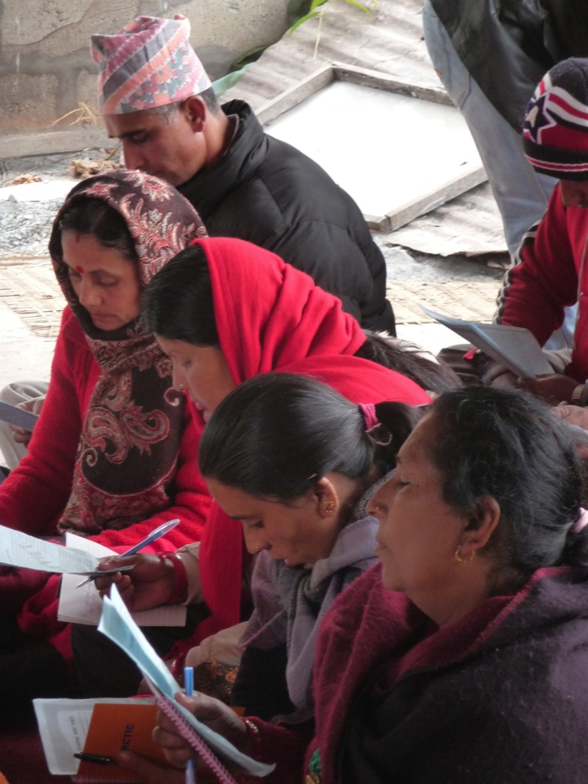
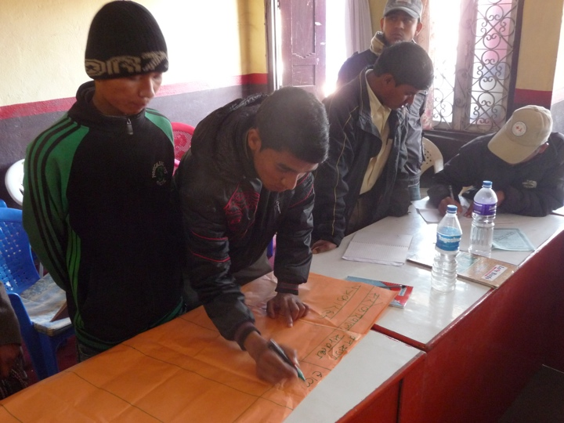
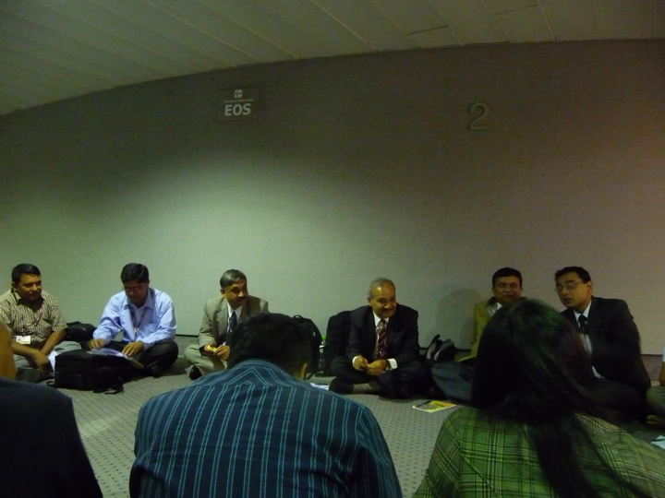
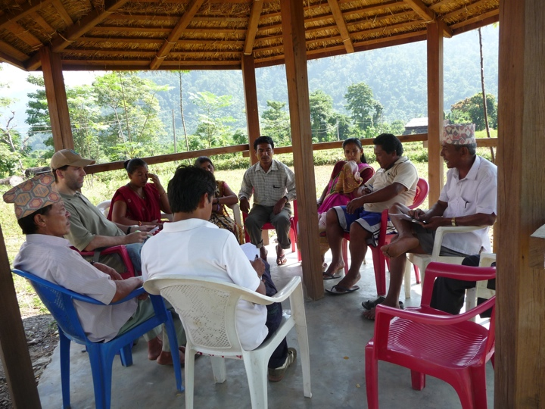
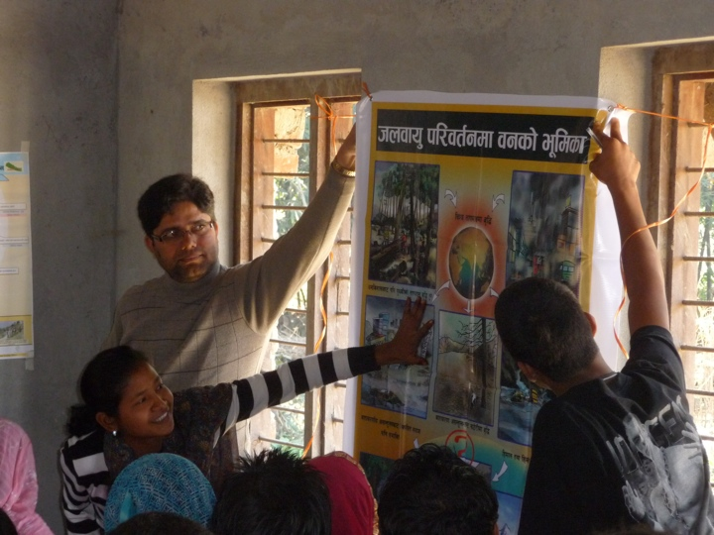
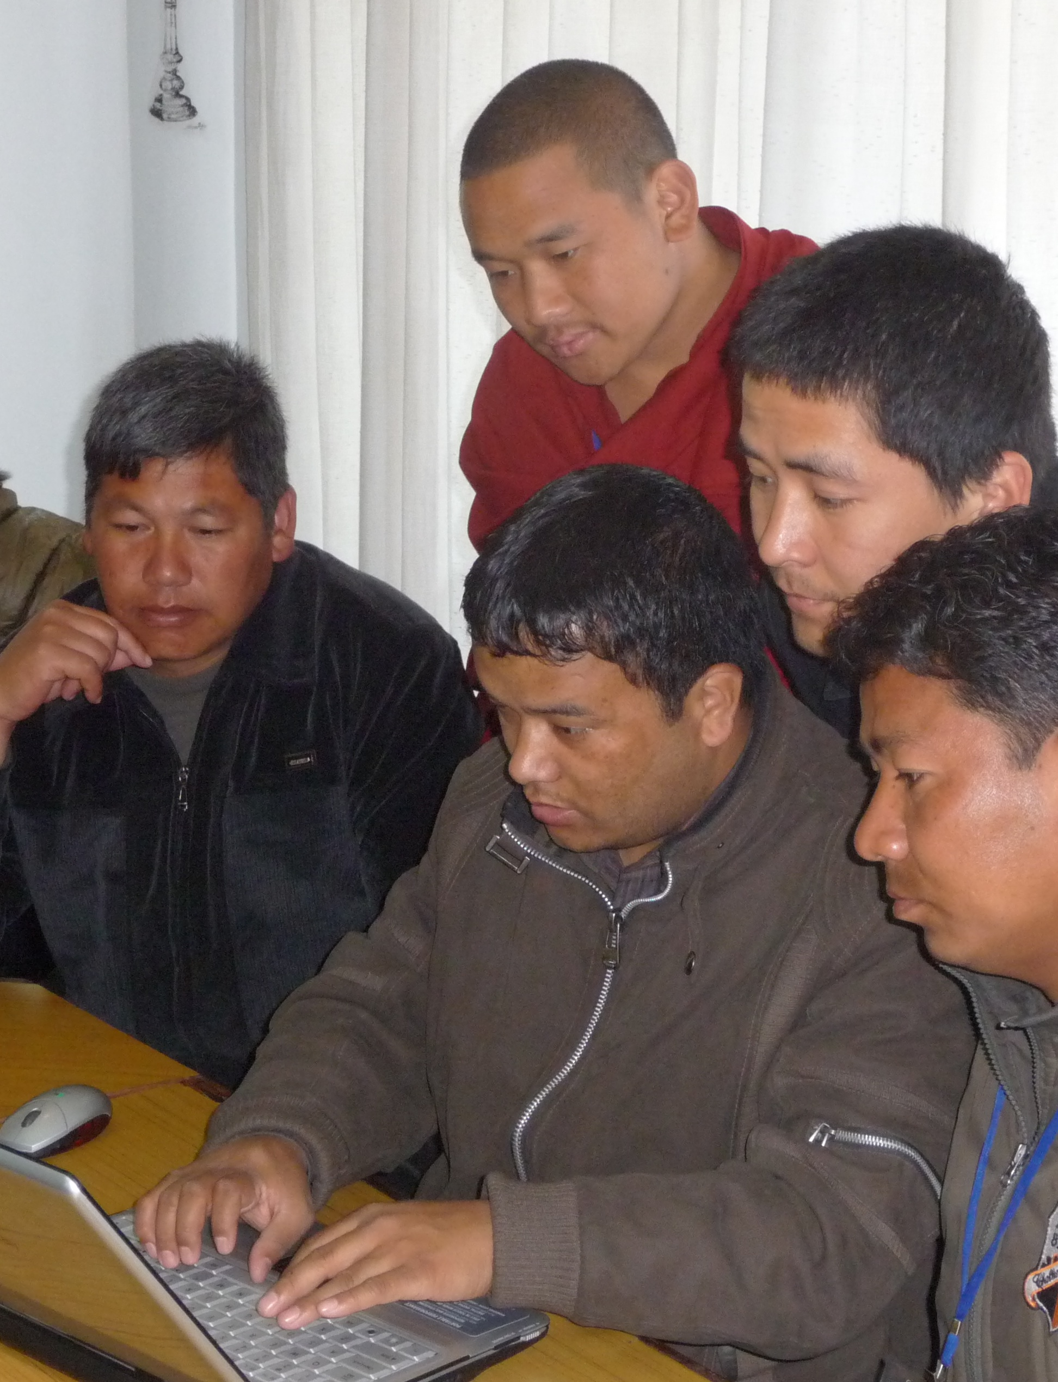
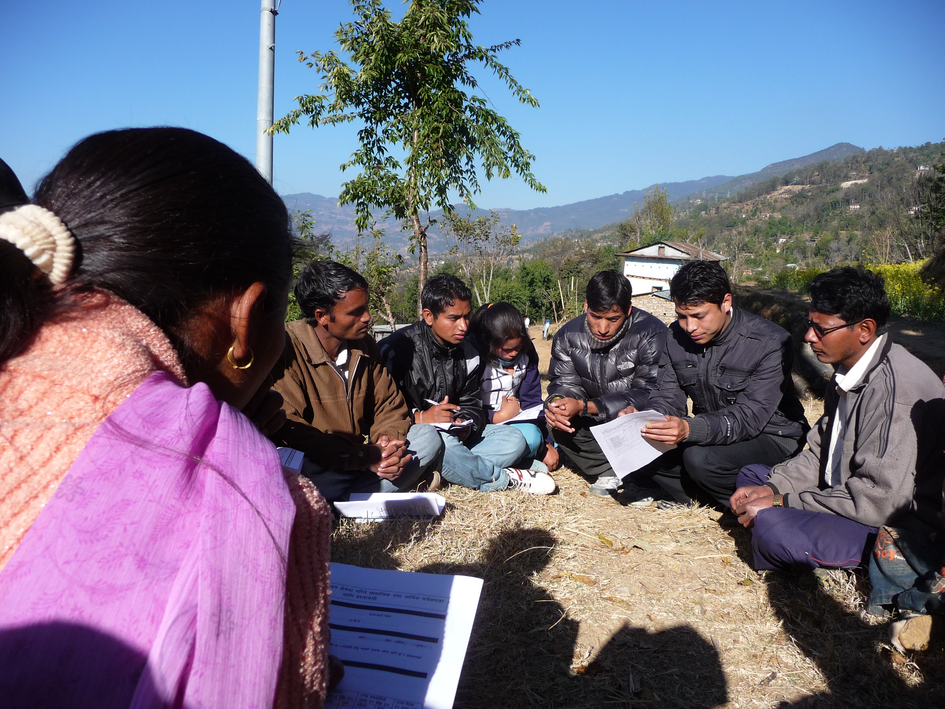
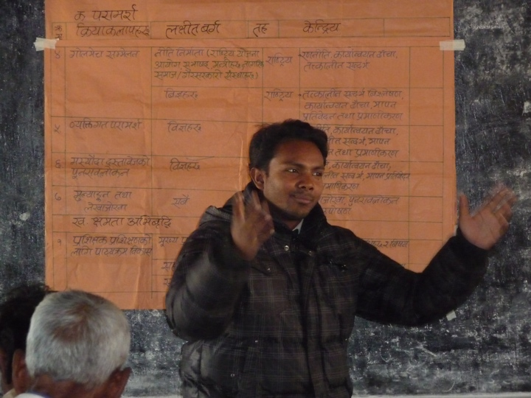
Specific REDD readiness activities
Photos by Bryan Bushley (2009-2010)

Slide 20
6. Challenges, lessons and implications for REDD
Opportunity or challenge for effective and equitable forest governance, rights and tenure security?
Imperatives in Nepal’s REDD readiness process:
Community ownership of land and carbon rights
Consensus on a fund-based vs. a market-based approach
Inclusion of more stakeholders and rights-holders
Increased awareness among indigenous and local communities and adherence to FPIC/SES

Slide 21
Risks of advancing with carbon trading without clearly defined and enforceable forest land/carbon tenure regimes:
Reward encroachers who occupy forests illegally and/or displace legitimate communities/landholders
Restrict access of marginalized groups and/or excluding them from REDD benefits
Diminish international investors’ willingness to support REDD projects (lower price of Nepal’s carbon)
Limited political will and capacity to carry out comprehensive tenure reform impedes realization of equitable benefits for all relevant stakeholders

Slide 22
Five measures to enhance Nepal’s benefits from carbon trading and REDD:
Clear, legally defensible basis (carbon rights) and rules for equitable distribution of benefits among all relevant stakeholders;
Integration of existing national laws and policies related to forestry and land use/reform with emerging legal framework for carbon trading (to remove subsidies and perverse incentives);
Expanded scope and channels for private sector participation in financing and facilitating forest carbon projects;
Democratic governance (institutional) framework to guide projects, guard against abuses, and ensure communities and individuals who manage/protect forests receive most benefits; and
Flexibility to account for different sub-national circumstances and ensure equitable benefits, based on recognition and reinforcement of existing tenure regimes and resource rights.

Slide 23
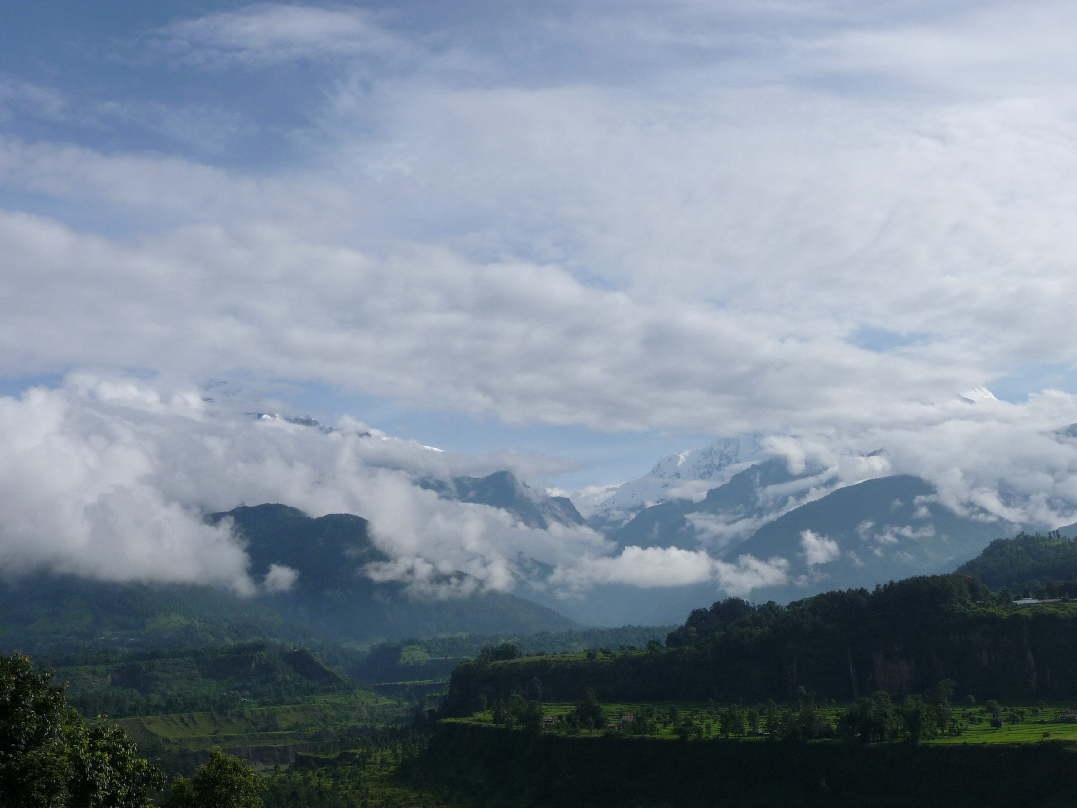
Dhanyabad ~ Thank You !
Contact: bushley@hawaii.edu
Land Tenure Center, University of Wisconsin, Madison USAID TransLinks Program
University of Hawai’i at Manoa East-West Center
US Educational Foundation Nepal (Fulbright) Social Science Research Council
Federation of Community Forest Users, Nepal ForestAction Nepal
Communities & Individuals in Nepal
Photo by Bryan Bushley (2008)

Slide 24
-End of Presentation-
Appendices…

Slide 25
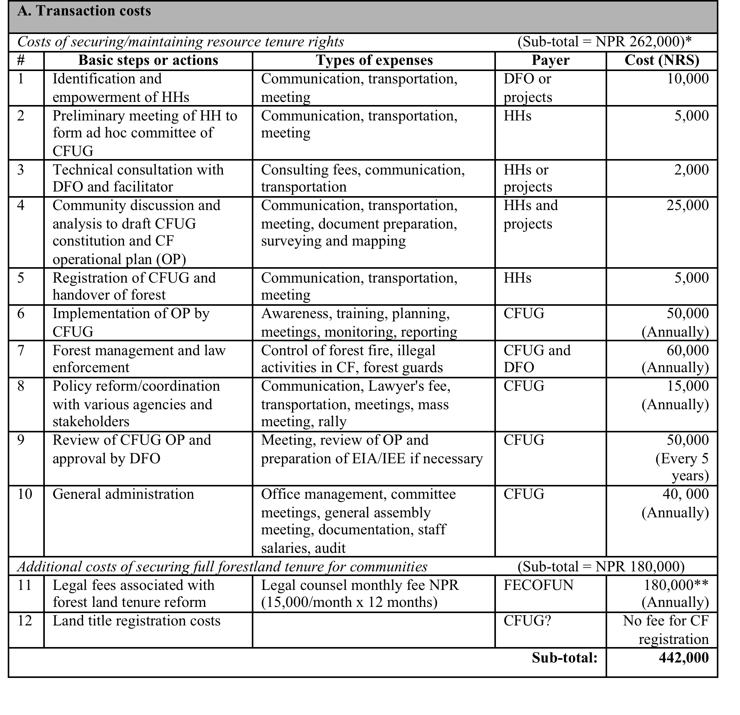
Costs of securing resource/land tenure
= USD $5,667 (10/17/2011)

Slide 26
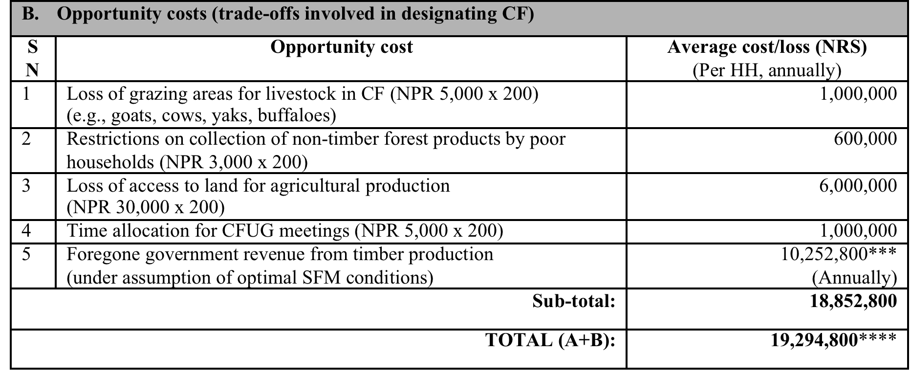
Costs of securing resource/land tenure (2)
= USD $241,703
= USD $247,369
NOTES:
* The cost of securing resource tenure rights (i.e., CF formation and administration) will not be the same for each CFUG. The cost may be higher or lower based on the number of households, the size of the forest area and the distance from the office of service providers, such as the DFO or facilitating NGOs.
** Legal fee estimate reflects FECOFUN’s average monthly cost of retaining counsel for legal proceedings. There is no way of knowing how many months would be needed, but based on past legal proceedings concerning forest tenure issues, it would likely take over a year.
*** Estimated benefit of 142,400 per hectare annually minus 15% royalty (NPR 21,360) and 13% VAT (NPR 18,512) currently paid by CFUGs to government (=NPR 102,528) x 100 hectares; based on the assumption of optimal, sustainable forest management conditions.
**** Expenditures are both one-time costs and annual costs, so the “TOTAL” reflects the cumulative costs after the initial year of CFUG/CF formation and securing land tenure, plus associated opportunity cost.
Source: Information on ‘basic steps’ from Community Forestry Development Program Guidelines (2009) and Community Forestry Inventory Guidelines (2004); cost estimates for each step from consultation with members of FECOFUN National Executive Committee, based on their experience working with CFUGs.

Slide 27
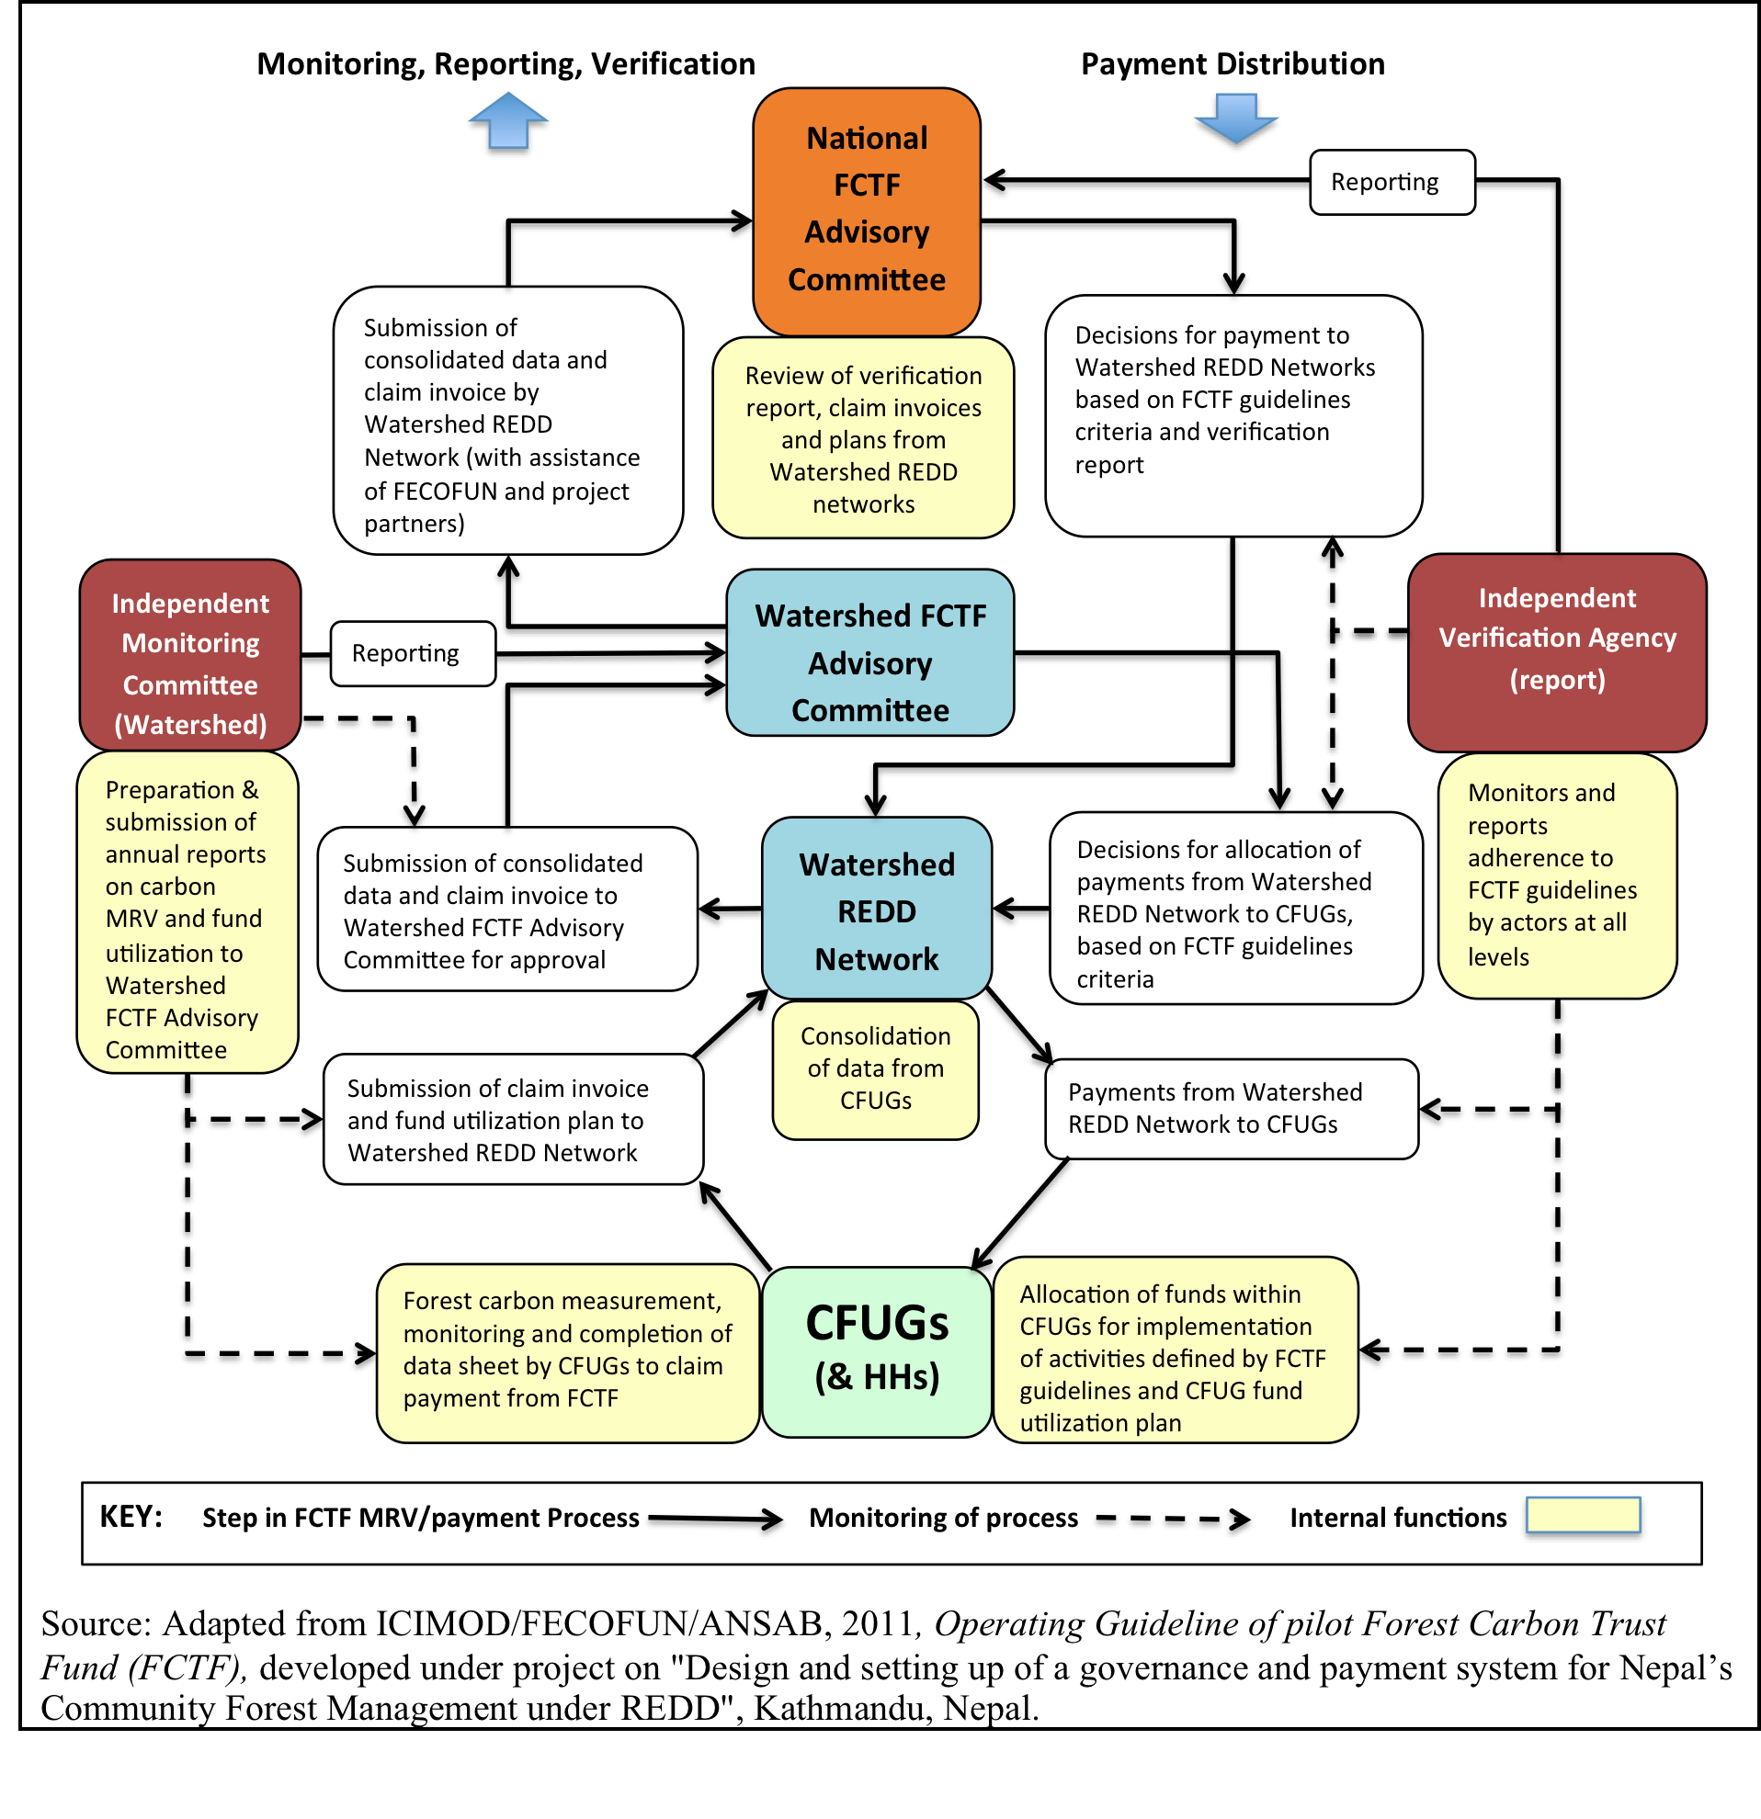
Proposed MRV and payment system

